Slide 1
Risk Management (RM) Refresher Training
2025
Col Kris Lamothe
Director of Safety
AFDW

Slide 2
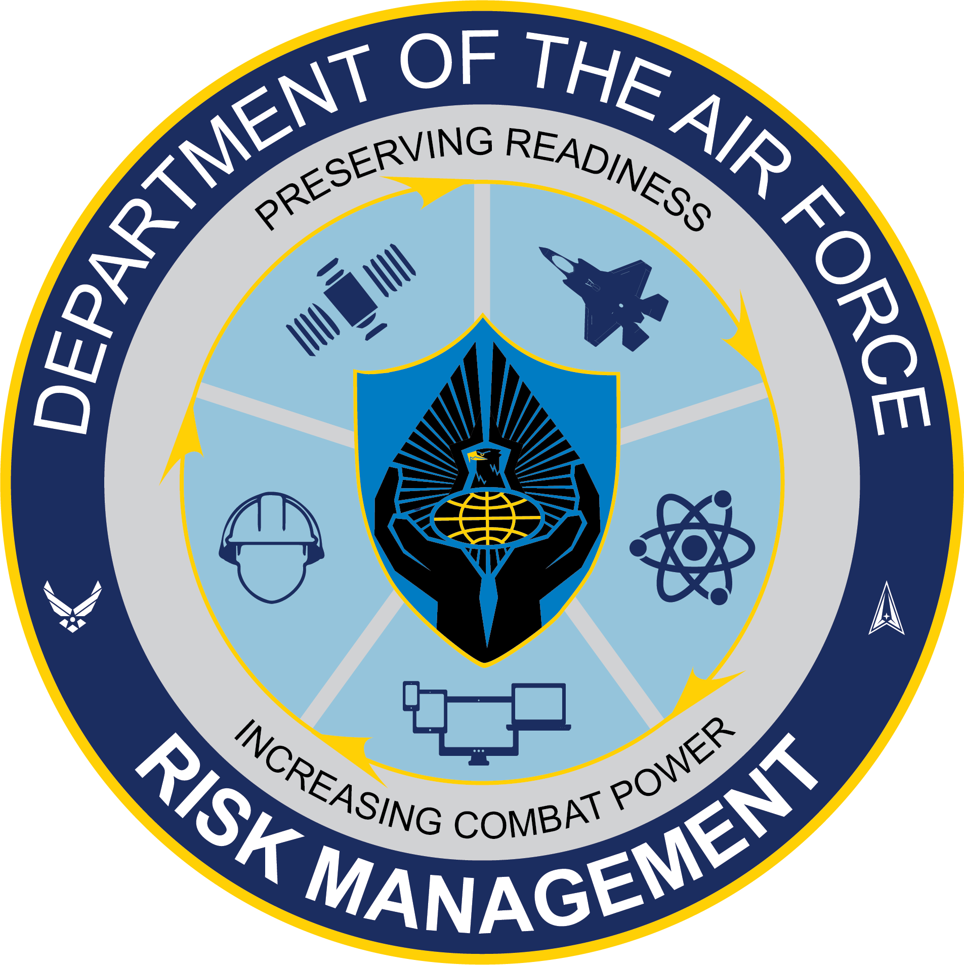
Overview
Purpose
Requirements
RM Fundamentals
RM Refresher
  Concepts
  Process
  Tools
RM Exercise
Summary

Slide 3
Purpose
Integrating Risk and Readiness (IRR) Campaign, PHASE 2
  CSAF-directed TASKORD
  Institutionalize Risk Management (RM) by full integration into training programs, operational plans, exercises, mission execution, and leadership development.
  Development and implementation of RM tools at all levels for all Air Force uniformed and civilian personnel.
  The goal is to train all Airmen on RM concepts and tools to increase readiness and build an operational force that understands and integrates RM and operational discipline into training, exercises, and combat operations.

Slide 4
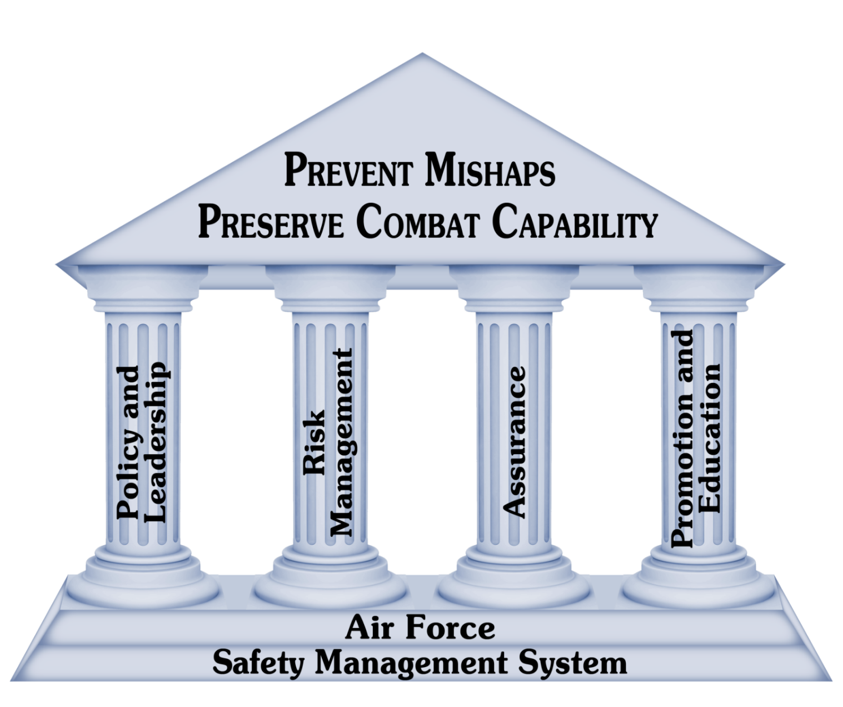
Purpose
End State
  100% of personnel completing RM training requirements
  100% of major exercises incorporate RM tools and Joint Risk Assessment Tool (JRAT) or other formal risk measurement tools
  100% integration of RM into formal education and training courses

Slide 5
Requirements
RM Fundamentals Training
  One time completion
  CBT or video-based training acceptable methods of completion
  Completion within 120 days after discrepancy discovery
RM Refresher Training
  Annual completion
  Scenario-based, tabletop exercise
  Accomplished individually or in groups of less than 20 members with a designated facilitator
  Completion by 31 Dec 2025

Slide 6
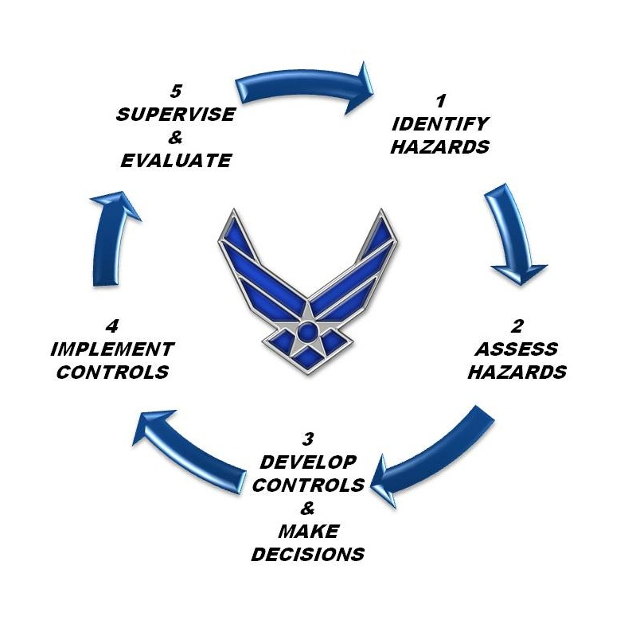
RM Fundamentals
Completion of RM Fundamentals training is required for all uniformed and civilian AF personnel
One time completion requirement; acceptable methods of completion:
  Computer-based training on myLearning
  Video-based training (authorized through the end of Calendar Year 2025)
Completion of RM Fundamentals DOES NOT count towards the annual RM Refresher Training

Slide 7
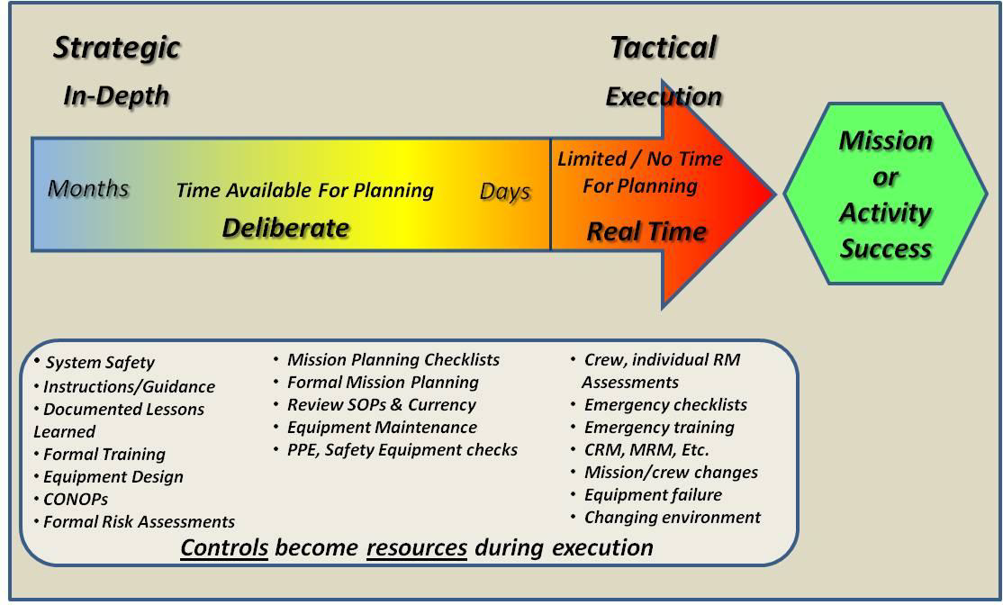
RM Refresher Training
All personnel will accomplish RM Refresher Training
Training will be accomplished individually or in small groups of less than 20 members with a designated facilitator
Expected time for each training should be no less than 1 hour
Notes:
Ensure training facilitators bring laptops for access to resources and ability to fill out DD Form 2977.
TASKORD goal is to standardize use of DD Form 2977, since that is the product generated from JRAT. This has not yet been updated in the DAFI 90-802 or DAFPAM 90-803, which still references the DAF Form 4437, Deliberate Risk Assessment Worksheet.

Slide 8
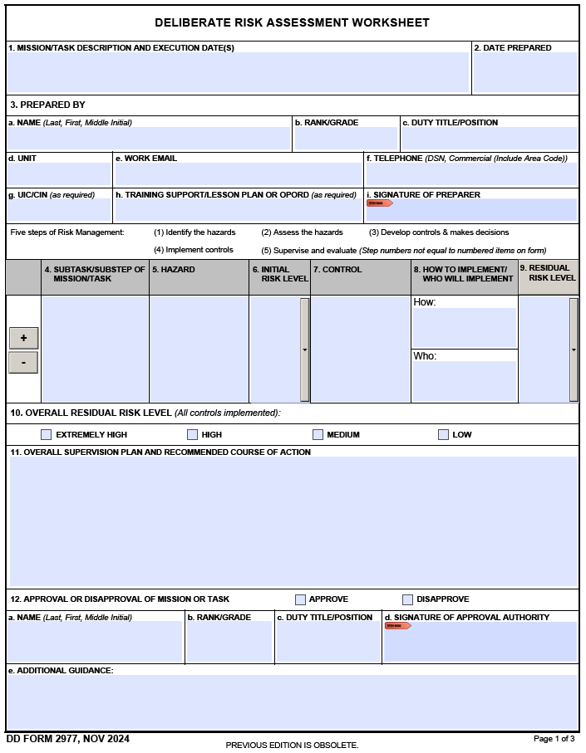
RM Refresher Training
Personnel will be presented with at least one provided mission-related scenario that ties closest to their mission set
  Library of scenarios located on RM AF Portal site
Once presented with scenario, personnel will:
  Identify hazards
  Assess initial risk levels
  Create mitigation measures
  Assess residual risk
  Fill out DD Form 2977, Deliberate Risk Assessment Worksheet, utilizing JRAT
Upon completion of the exercise, personnel will compare their DD Form 2977 against the “correctly” filled out DD Form 2977 example provided with the scenarios
Notes:
Ensure training facilitators bring laptops for access to resources and ability to fill out DD Form 2977.
TASKORD goal is to standardize use of DD Form 2977, since that is the product generated from JRAT. This has not yet been updated in the DAFI 90-802 or DAFPAM 90-803, which still references the DAF Form 4437, Deliberate Risk Assessment Worksheet.

Slide 9
RM Concepts

Slide 10
AFSMS

Slide 11
Risk Defined
“Chance of adverse outcome or bad consequence, such as injury, illness, or loss. Risk level is expressed in terms of hazard probability and severity.”
DoDI 6055.01 (p.41)
“The probability and severity of loss or adverse impact from exposure to various hazards.”
DAFI 90-802 (p.29)
DAFPAM 90-803 (p.47)

Slide 12
RM Defined
A process that assists organizations and individuals in making informed decisions in order to reduce or offset risk, thereby increasing operational effectiveness and the possibility of mission success.
DoDI 6055.01 (p.42)
The systematic process of identifying hazards, assessing risk, analyzing risk control options and measures, making control decisions, implementing control decisions, accepting residual risks, and supervising/reviewing the activity for effectiveness.
AFPD 90-8 (p. 9)
A decision-making process to systematically evaluate possible courses of action, identify risks and benefits, and determine the best courses of action for US Air Force and US Space Force (USSF) personnel for any given situation.
DAFI 90-802 (GM)
The systematic process of identifying hazards, assessing risk, making control decisions, implementing control decisions and supervising/reviewing the activity for effectiveness.
DAFPAM 90-803 (p.47)

Slide 13
RM Tenets
Risk is inherent in all missions, operations and activities, both on and off-duty.
Risk may be effectively mitigated if understood and appropriate action is taken.
All personnel are responsible for utilizing RM concepts, tools and techniques.
The RM process outlined herein applies to risk-related decisions when such decisions are not governed via separately established requirements and guidelines, e.g., statutes, regulations, technical orders, and Department of Defense or Air Force policy and guidance that address personnel health and safety or environmental matters and dictate particular decisions or outcomes within these requirements and guidelines.
DAFI 90-802 (p.4)

Slide 14
RM Goals
Enhance mission effectiveness at all levels, while preserving assets and safeguarding health & welfare.
Create an AF cultural mindset in which every Airman, leaders at all levels and all AF civilian employees are trained and motivated to manage risk in all their on- and off-duty activities.
Integrate RM into mission and activity planning processes, ensuring decisions are based upon risk assessments of the operation or activity.
Identify opportunities to increase AF war fighting effectiveness in all environments and ensure success at minimal cost of resources. The RM process shall be institutionalized and be an inherent part of all military operations to address safety, occupational and environmental health risks.
DAFI 90-802 (p.4)

Slide 15
RM Does Not:
Inhibit flexibility, initiative or accountability in any chosen course of action.
Remove risk altogether or support a Zero-Defect mindset.
Take the place of training, practice, drills, rehearsals, tactics, techniques and procedures associated with a specific event or action.
Override or supersede compliance with federally mandated DOD, OSHA standards, federal environmental cleanup standards, AF standards and criteria, or any risk-based statutory and regulatory requirements that apply and dictate the outcome of such requirements.
DAFI 90-802

Slide 16
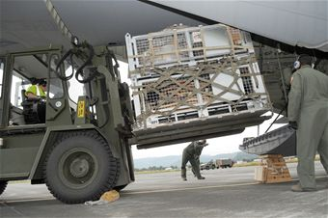

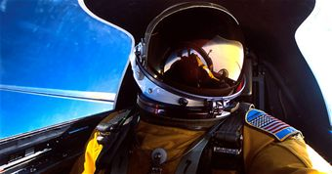
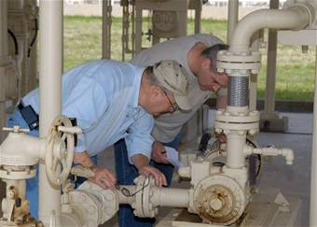
RM Principles
Accept no unnecessary risk.
Make risk decisions at the appropriate level.
Integrate RM into operations, activities and planning at all levels.
Apply the process cyclically and continuously.
DAFI 90-802 (p.14/GM)

Slide 17
Two Levels of RM
Deliberate RM
  Complete 5-Step RM process
  Timeframe: days or months
  Resources are abundant, availability may vary, but can obtain and utilize prior to “execution”.
  Application: Applies to all pre-planned events; critical to large scale operation or activity success.
Real-Time RM (RTRM)
  An abbreviated 5-Step process
  Timeframe: Real-time, “On the run,” time critical
  Resources are limited to what is available now!
  Application: Applies to all active operations or activities while they are underway.
Notes:
CITE: Remind folks – Is it Dumb, Dangerous or Different?? Then maybe it shouldn’t be done!

Slide 18
Two Levels of RM
DAFI 90-802 (p.15)

Slide 19
RM Process

Slide 20
The Deliberative 5-Step RM Process
Identify hazards
Assess hazards
Develop controls &
make decisions
Implement controls
Supervise & evaluate
effectiveness of controls – repeat!

Slide 21
Step 1 – Identify the Hazards

Slide 22
Hazard Defined
“Any real or potential condition that can cause injury, illness, or death to personnel or damage to or loss of equipment or property, mission degradation.”
DoDI 6055.01 (p.40)
AFPD 90-8 (p.8)
“A condition with the potential to cause injury, illness or death of personnel, damage to or loss of equipment or property, or mission degradation.” DAFI 90-802 (p.29)
DAFPAM 90-803 (p.46)

Slide 23
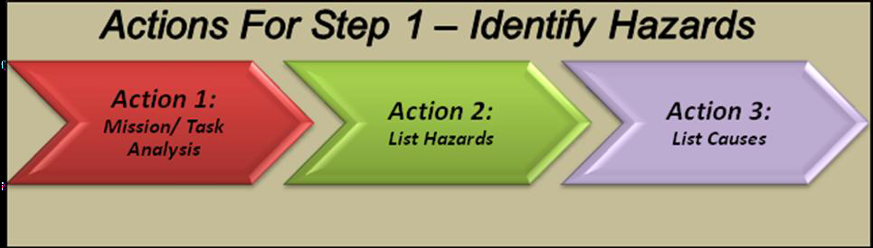
Step 1 – Identify the Hazards
Notes:
CITE: “Failing to plan is planning to fail.” Consider discussing the story of Aaron Ralston (127 Hours) who was a high risk taker who thought the weekend trip to go hiking and rappelling by himself was a low risk event, but turned into a life or death situation as a result of his failure to plan.

Slide 24
Step 1 – Identify the Hazards
Action 1:
Mission / Task Analysis
Mission statements, planning documents, and other resources
Major phases or steps
Key capabilities & required resources
Past issues or mishaps
Utilize experienced personnel for input on planning
Notes:
Always start with the mission statement, written or verbal.
Create a list or chart to show the major phases or steps in the job process.
It is also helpful to use a timeline to help understand the flow of the proposed mission.
If this mission, or one like this mission, has been done in the past, there will be after action reports, lessons learned, etc. These will help you decide what to include in your list. You’re doomed to repeat if you don’t look at past issues.
Get the right people involved to help ID the hazards.

Slide 25
Step 1 – Identify the Hazards
Action 2:
List Hazards
List hazards associated with each step or phase of the operation or activity.
“A condition with the potential to cause injury, illness or death of personnel, damage to or loss of equipment or property, or mission degradation.”
Notes:
Cite: For example, a warm weather (WX) unit deploying their personnel to a cold WX environment. They may not perform as effectively – cold hands, inadequate gear for the environment, takes time to adapt, etc.
If this mission or one like this mission has been done in the past there will be after action reports, lessons learned, etc., that will help you decide what to include in your list.

Slide 26
Step 1 – Identify the Hazards
Action 3:
List Causes
List causes associated with each hazard identified.
  Identify “Root” causes of each hazard.
  Hazards may have multiple root causes.
  Risk Controls will be developed to eliminate or mitigate root causes.
Notes:
Note: Can hand out the 5 whys of root cause info sheets at this time to class.
Five Whys? Why did the plane crash? Because there was an engine fire.
Why was there an engine fire? Because there was a fuel leak.
Why was there a fuel leak? Because a fuel line cracked and leaked fuel.
Why did the fuel line crack? Because a bolt on an attachment point was torqued too tight and created a stress on the line.
Why was the bolt torqued too tight?? Because the mechanic failed to follow proper Tech Order procedures and did not reference the correct torque setting.
How do you prevent over-torqueing? Better training on wrench use.

Slide 27
Step 2 – Assess Hazards

Slide 28
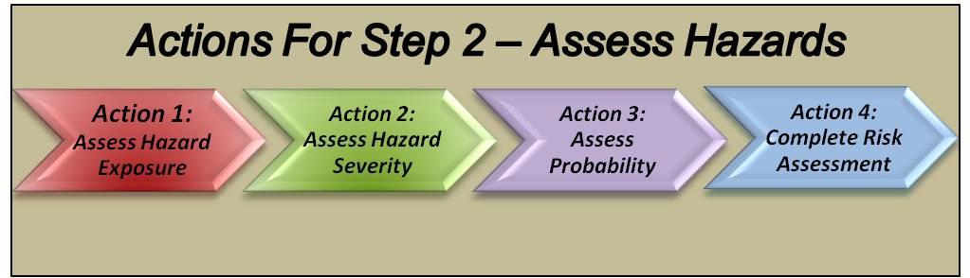
Step 2 – Assess Hazards

Slide 29
Step 2 – Assess Hazards
Action 1:
Assess Hazard Exposure
Expressed in terms of time, proximity, volume, or repetition.
Does it happen often, or near personnel or equipment?
Repeated exposure increases the “Probability” of a mishap.

Slide 30
Step 2 – Assess Hazards
Action 2:
Assess Hazard Severity
    Expected consequences of an event in terms of mission impact, injury, or damage
    Based on worst possible outcomes that can be reasonably expected
    Cause and Effect diagrams and “What-if” analysis

Slide 31
Step 2 – Assess Hazards
Action 2:
Assess Hazard Severity
      Catastrophic: Complete mission failure, death, or loss of system.
      Critical: Major mission degradation, severe injury, occupational illness or major system damage.
      Moderate: Minor mission degradation, injury, minor occupational illness, or minor system damage.
      Negligible: Less than minor mission degradation, injury, occupational illness, or minor system damage.

Slide 32
Step 2 – Assess Hazards
Action 3:
Assess Probability
Likelihood that a particular hazard will occur
  Estimates or actual numbers
  Research, analysis, and historical safety data

Slide 33
Step 2 – Assess Hazards
Action 3:
Assess Probability
      Frequent: Often in the life of the system, probability occurrence greater than 10%, continuous.
      Likely: Several times in the life of the system, probability of occurrence less than 10% but greater than 1%, occurs regularly.
      Occasional: Will occur in the life of the system, probability of occurrence less than 1% but greater than 0.1%, sporadic.
      Seldom: Possible to occur in the life of the system, probability of occurrence less than 0.1% but greater than .0001%, may occur.
      Unlikely: Assume it will not occur in the life of the system, probability of occurrence less than 10⁻⁶ in the life of the system, very rare.

Slide 34
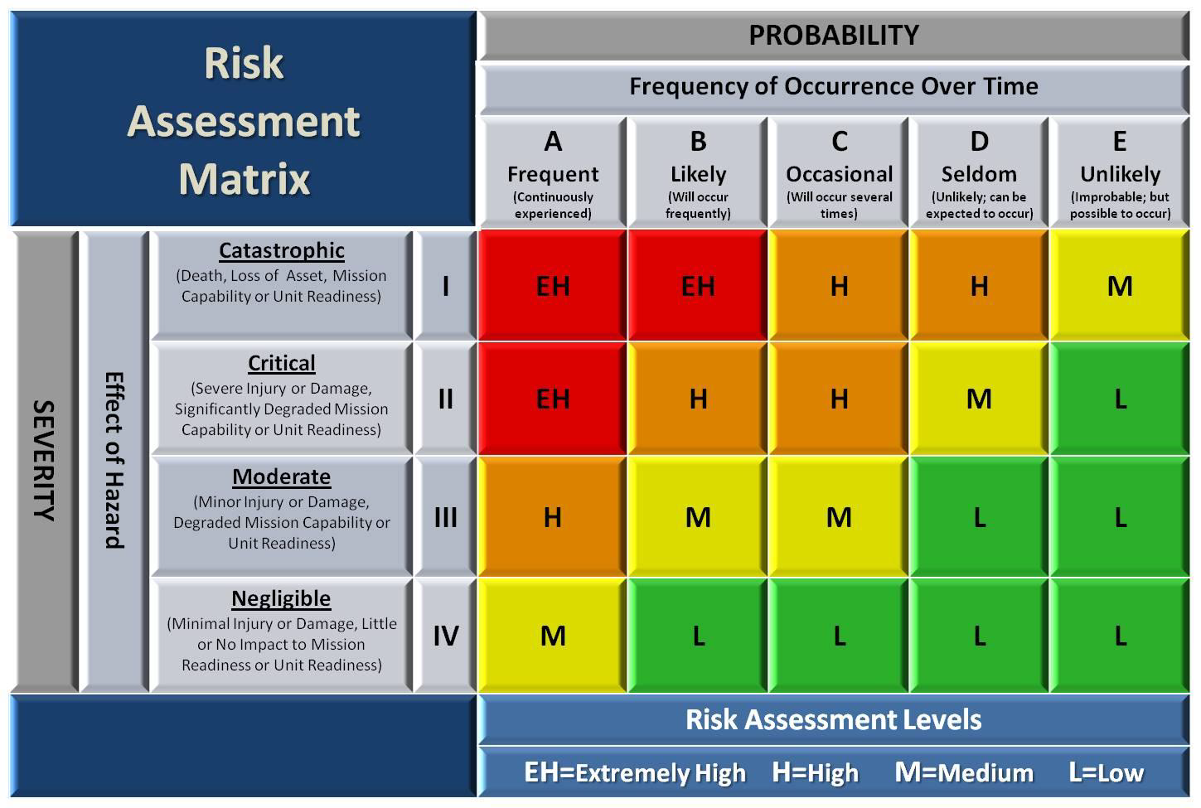
Step 2 – Assess Hazards
Action 4:
Complete Risk Assessment
H

Slide 35
Step 2 – Assess Hazards
Action 4:
Complete Risk Assessment
What about Exposure??
Repeated exposure to a hazard increases the probability of a mishap occurring and can result in planners increasing the risk assessment level based upon the increased exposure.

Slide 36
Step 2 – Assess Hazards
Action 4:
Complete Risk Assessment
Notes:
Complete step 2 by listing the risks from most serious threat to least serious

Slide 37
Step 3 – Develop Controls & Make Decisions

Slide 38
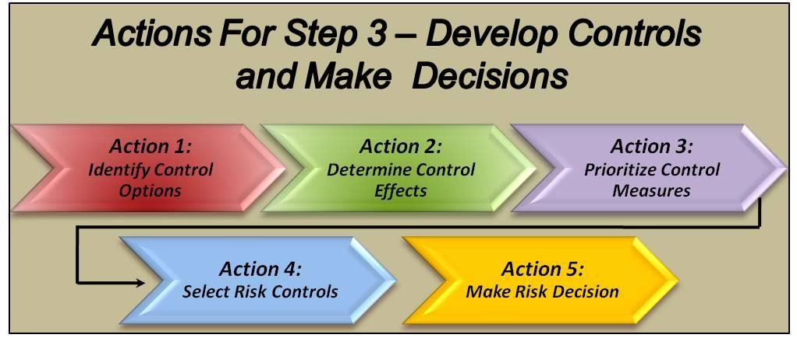
Step 3 – Develop Controls & Make Decisions

Slide 39
Step 3 – Develop Controls & Make Decisions
Action 1:
Identify Control Options
One or more controls to eliminate or reduce the risk to an acceptable level
Involve personnel impacted by risk controls
Control Options Matrix, Mission Mishap Analysis, What-If Analysis

Slide 40
Step 3 – Develop Controls & Make Decisions
Action 1:
Identify Control Options
Types of controls
  Engineering Controls
  Physical Controls
  Administrative Controls
  Educational Controls
  Operational Controls
Notes:
Rank Order (preferred) of controls:
Engineering Controls: Design, material selection or substitution
Best risk control when dealing with systems or acquisition development issues
Most costly option (time and material)
Physical Controls:
Barriers, guards, and personal protective equipment (PPE)
Administrative Controls:
Warnings, markings, placards, signs, notices
Policies, programs, instructions, standard operating procedures
Limit exposure
Educational Controls:
Knowledge and skill
Operational Controls:
Pace of operations, battlefield controls, rules of engagement, airspace control measures, map exercises, and rehearsals

Slide 41
Step 3 – Develop Controls & Make Decisions
Action 1:
Identify Control Options
Eliminate or mitigate the risk of a hazard
  Rejection
  Avoidance
  Delay
  Transference
  Spreading
  Compensation
  Reduction
Notes:
Rejection
Refusal to take the risk if the overall cost exceeds its benefit
Avoidance
Avoid the risk by going around them or accomplishing the operation / activity in a different way
Delay
Assumes no set timeline for the operation / activity; delaying may result in a situational change, reduction in risk, or other options to become available (Wx)
Transference
Transfer all or some portion of the task to another individual, unit, or platform better suited for the task (RPA)
Spreading
Refers to the movement of forces, equipment, or tasks to other areas in order to avoid risk to the entire operation / activity; i.e., distance between assets and increased time between events (exposure) (Convoy Ops)
Compensation
Assign redundant capabilities to ensure the success of critical missions or tasks; i.e., redundant flight controls, designated driver, B/U aircraft, attacking a high value target with multiple assets
Reduction
Reducing the number of individuals, equipment or resources exposed to a particular risk (Exposure)

Slide 42
Step 3 – Develop Controls & Make Decisions
Action 2:
Determine Control
Effects
How does each control affect the risk associated with the hazard?
With controls identified, the hazard should be re-assessed for Severity and Probability.
Record the new risk level (residual risk) – how does the control affect the original risk level?

Slide 43
Step 3 – Develop Controls & Make Decisions
Action 3:
Prioritize Control Measures
Consistent with operational or activity objectives and optimize use of available resources.
Opportunity assessments, cost benefit analysis and computer modeling.
Feasibility of controls, balance costs & expected benefits in terms of mission performance, dollars & continued risk exposure during implementation.
Clearly define tradeoffs for the decision maker.

Slide 44
Step 3 – Develop Controls & Make Decisions
Action 4:
Select Risk Controls
Decision makers select control(s) that reduce risk to an acceptable level.
Accept the risks and associated consequences of implementing or not implementing recommended controls.
Ensure control decisions are documented for future reference.
Notes:
Cost will always be major player now.
Cite: At Holloman AFB, they had some old buildings with two prong outlets (vice the now normal 2 + ground). The cleaning ladies cut the ground prong off their vacuum cleaners so they could use them in the “old” buildings with the 2 prong outlets.
Solutions offered: Re-wire building at a cost of many thousands of dollars OR purchase several 2 prong (double insulated ) vacuum cleaners for several hundred dollars.
Setting up a process to ensure after-action reports, surveys and real-world measurements of controls are in-place. This will be important for Step 5, Supervise/Evaluate to get the feedback necessary.

Slide 45
Step 3 – Develop Controls & Make Decisions
Action 5:
Make Risk Decision
Decision Maker makes final decision – do current conditions warrant a “Go” or “No-Go?”
Level of risk for proposed controls in place
Cumulative risk of all hazards and long-term consequences of decision
If costs outweigh the benefits or exceed the “Go/No-Go” threshold – other alternatives?
  Elevate the decision to a higher authority or,
  Cancel or delay the operation or activity until conditions warrant

Slide 46
Step 4 – Implement Controls

Slide 47
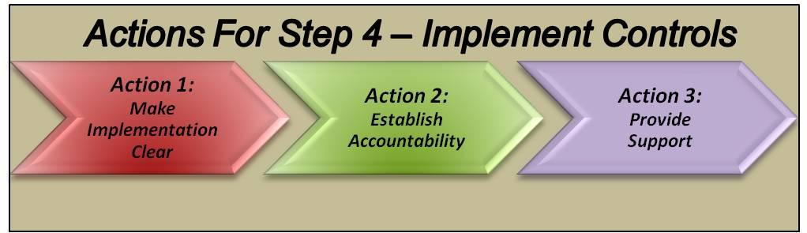
Step 4 – Implement Controls

Slide 48
Step 4 – Implement Controls
Action 1:
Make
Implementation
Clear
Roadmap for implementation, a vision of the end state, describe successful implementation
Controls deployed in a way that ensures they will be received positively
Buy-in

Slide 49
Step 4 – Implement Controls
Action 2:
Establish
Accountability
  Accountable person is also the decision maker – accepts the consequences.
  As risk increases so does the level of authority required to approve/disapprove.
  Those charged with implementation of the controls are aware of the cost and benefits.
  The accountable individual is known by all participants.

Slide 50
Step 4 – Implement Controls
Action 3:
Provide
Support
Personnel and resources are allocated to support the plan and selected risk controls.
Involvement of personnel impacted to achieve ownership.
Design in sustainability.
Develop supporting tools, guides, and / or infrastructure to support risk control implementation.
Develop timelines.

Slide 51
Step 5 – Supervise & Evaluate
Notes:
This final step is essential to a healthy RM process and the step that is most often neglected over time in an
ongoing RM situation.

Slide 52
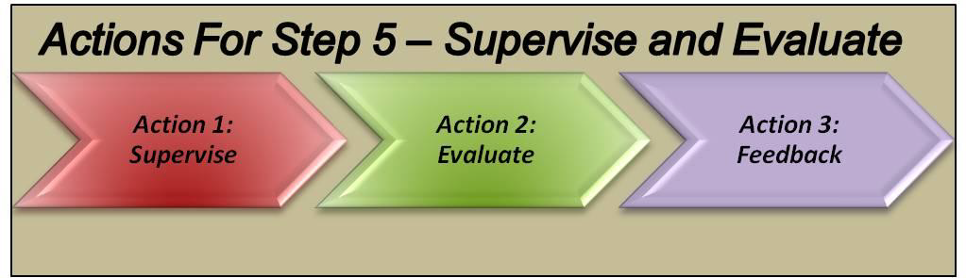
Step 5 – Supervise & Evaluate

Slide 53
Step 5 – Supervise & Evaluate
Action 1:
Supervise
Controls effective and remain in place
Action taken to correct ineffective risk controls
Changes identified
Anytime there is change, risks and control measures should be reevaluated
Reinitiate the process as new hazards identified

Slide 54
Step 5 – Supervise & Evaluate
Action 2:
Evaluate
Measure if controls are achieving their intended purpose.
After assets are expended to control risks, a new cost benefit evaluation required.
  Are actual cost in-line with expectations?
  Are control measures affecting the mission?
  Were changes or unexpected issues encountered?
As new hazards or changes identified, ensure appropriate controls are applied.
  After action reports, observations, data analysis, and lessons learned.
Notes:
CITE: Atch 7, 90-803 Pamphlet – Tool Control effectiveness Index program – QA checks, quizzes, etc. Add up percentages and find the effectiveness indexes. Also has examples of measuring the effectiveness of protective clothing/equipment risk index and an emergency procedures index (ability for a shop to respond to various emergencies such as fire or hazmat).
Review the way the index is derived so you can explain how to implement it to ensure evaluation action is accomplished.

Slide 55
Step 5 – Supervise & Evaluate
Action 3:
Feedback
Ensure those involved understand how effective the controls are.
Changes without providing reasons results in loss of ownership at lower levels.
Feedback must be shared with units with similar risks to ensure universal benefit.
Without feedback, there is no way to evaluate if previous forecasts were accurate, flawed, or completely incorrect.

Slide 56
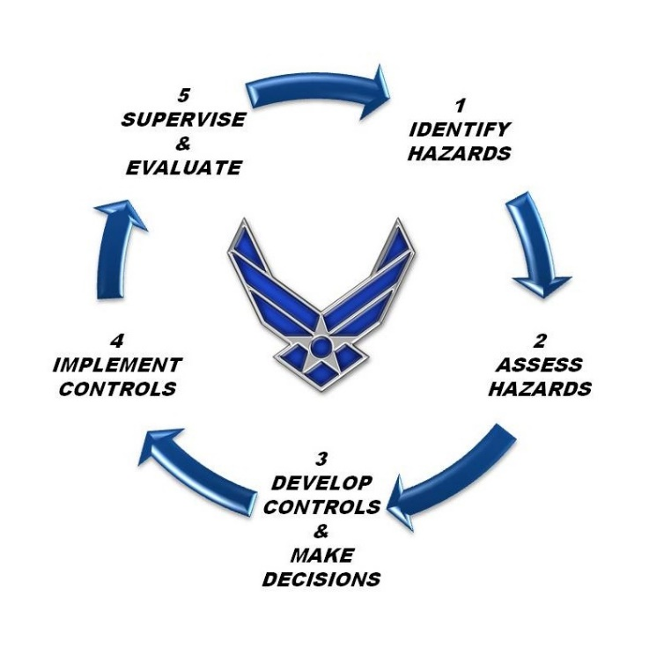
Real-Time Risk Management (RTRM)
Follows the same 5-Step process but compressed time, in the execution phase, yields some unique challenges.
Notes:
Less time to explore options and acquire expertise.

Slide 57
Real-Time Risk Management (RTRM)
Communication
Dynamic environments drive changes to perception and communication
  Increased stress
  Loss of situational awareness
  Reduced communication
Identification and awareness
  “Who needs to know?”
  “Who can assist?”
  “Can we do this differently?”
Notes:
Communicate: Various forms such as RT communication with leadership to discuss problems or intentions, internal team comm to discuss RT hazards or internalizing and taking time to evaluate if “going down the right path.” Communication can help when stress increases and loss of SA occurs. Understanding this can ensure the team will be prepared to anticipate/ID this situation and allow someone who has lost SA to “recover.” Questions such as “who needs to know,” “can this be done differently?” and “who can provide back-up?” are useful considerations when implementing a RT mitigation strategy.
Off-duty: Use the “5 sec rule” … ask the question: Am I making a good decision??
“Is this Dumb, Dangerous or Different?” Maybe it merits a bit more thought as to whether it should be done.
Could better communication have made a difference in the example of the aircrew we discussed earlier?
Consequences of risk must be taken seriously!

Slide 58
Real-Time Risk Management (RTRM)
Make the “Go or No-Go”/“Knock it Off”/“Timeout” decision based upon real-time conditions.
Take immediate or near immediate action to mitigate risks.
RTRM may require change to original plans.
  Can or should these changes be made?
Who is accountable?
  Consequences of actions to individuals, team members, mission?
Have a formal debrief.
  Was our original assessment accurate?
  Were we lucky?
  How well did we utilize our controls and resources?
  How do we improve?

Slide 59
RM Tools

Slide 60
RM Tools
METT-TC Model
  (Mission, Enemy, Terrain/Wx, Troops/Support Avail, Time Avail, Civil Considerations)
5-M Model (Men, Mission, Media, Machine, Management)
Operational Analysis (Sequence of Events, Focus on most risky aspects)
Preliminary Hazard Analysis (PHA)
“What-If” Tool (WIT)
Scenario Process Tool (Hazard ID through visualization)
Logic Diagram (Graphical depiction of events focused on linkage of hazards)
  Positive, Neutral, Negative Event Diagrams
Change Analysis (Used whenever significant change occurs, specific task focused)
Cause and Effect Tool (More thorough Logic Diagram)
Root Cause Tool (5 Why’s to determine causes of hazards)

Slide 61
METT-TC Model
Step 1
Action 1:
Mission / Task Analysis
  Mission: Analyze the assigned mission, type of mission, subsequent missions.
  Enemy
  Terrain & Weather
  Troops & Support Available: Training levels, manning levels, condition and maintenance of equipment, morale, availability of supplies and services, and the physical and emotional health of personnel.
  Time Available: 2/3 of time available for planning, 1/3 for execution.
  Civil Considerations: Infrastructure, civilian institutions, attitudes and activities of leaders and populations – ROE.
Notes:
AFPAM90-803 (p.13-15)
Joint or combat operations
Mission: Decision makers analyze the assigned mission. Look at the type of mission to be accomplished and consider possible subsequent missions.
Enemy: Look for enemy capabilities that pose risks to the operation; i.e., “What can the enemy do to defeat my operation?”
Terrain & Weather: Terrain and weather pose great potential hazards to military operations. The unit must be familiar with both the terrain and its associated environment for a mission to succeed.
Troops & Support available: Analyze capabilities of available troops. Key considerations: training levels, manning levels, condition and maintenance of equipment, morale, availability of supplies & services, and the physical/emotional health of personnel.
Time Available: Planning time is a premium. Decision makers should routinely apply the 2/3 – 1/3 rule when able (use 2/3 of time available for planning, 1/3 for execution). This ensures units and / or personnel have maximum time to plan.
Civil Considerations: Consideration must be given to the influence of man-made infrastructure, civilian institutions, attitudes / activities of leaders, populations, and organizations within an AOR on the conduct of planned operations.

Slide 62
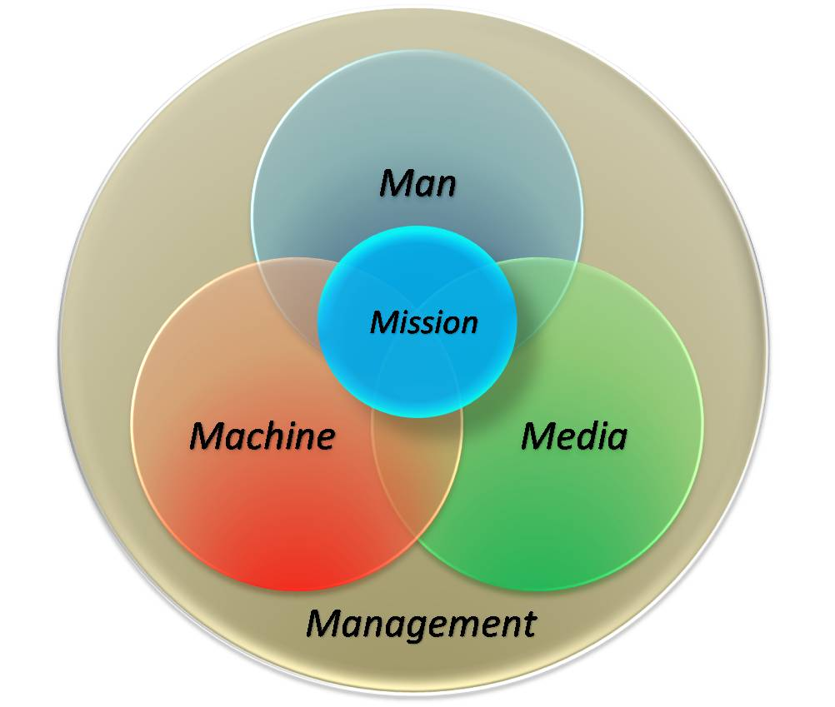
5-M Model
Step 1
Action 1:
Mission / Task Analysis
The 5-M Model
Notes:
AFPAM90-803 (p.15-17)

Slide 63
Operations Analysis (OA)
Step 1
Action 1:
Mission / Task Analysis
Itemized sequence of events or diagram of major events
Eliminates focusing on most risky aspects at the exclusion of all others
Guide allocation of resources over time
Mission planners who are experienced in the operation
A cornerstone tool used in almost all RM situations
All elements of the operation are evaluated for risks
All elements of an operation are evaluated for sources of risk

Slide 64
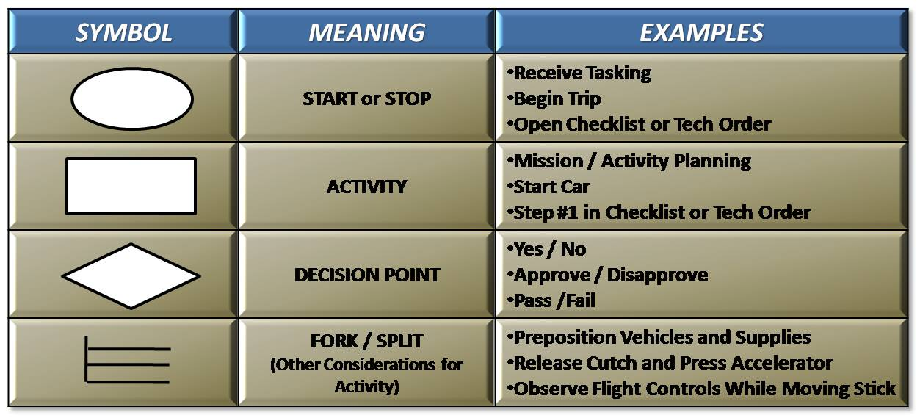
Operations Analysis (OA)
DAFPAM 90-803 (p.49)

Slide 65
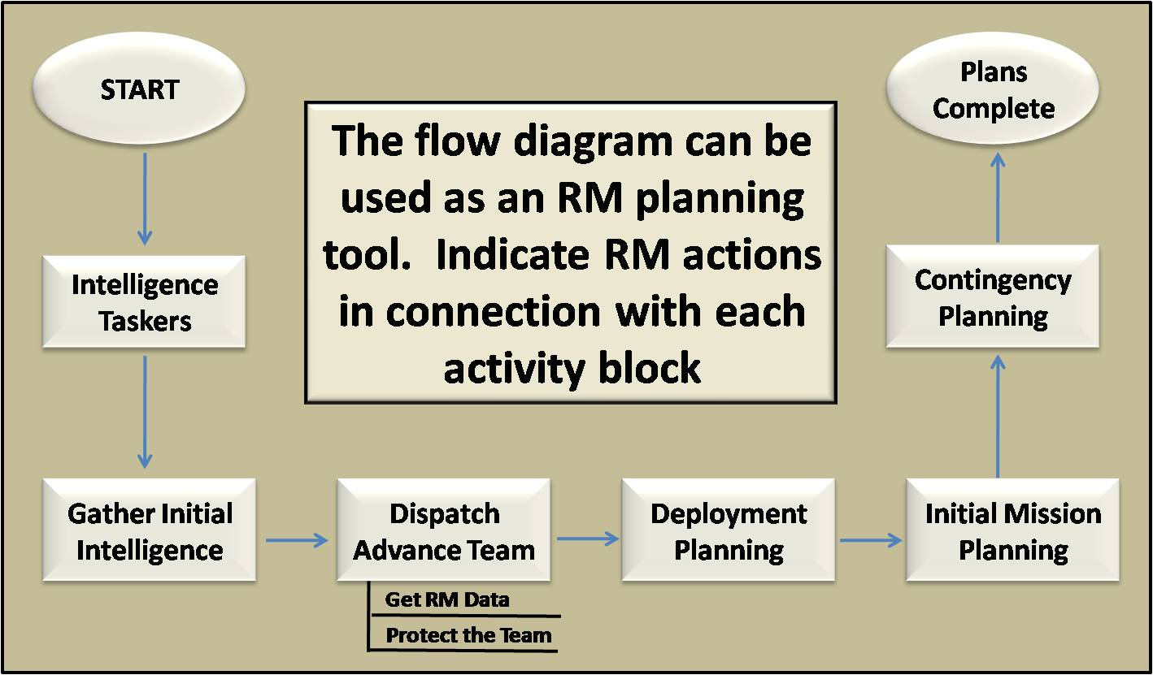
Operations Analysis (OA)
.
DAFPAM 90-803 (p.51)

Slide 66
Operations Analysis (OA)
Day 1-10 Gather Evidence
Day 11 - 20 Analyze Evidence
Day 21-30 Prepare Deliverables
Pre-Mishap Plan Approved
Potential Board Members Trained
OPREP-3 PA News Release
SIB in Place
Completion Date for CONUS RPA
Mishap (M) M + 1 hour M + 1 day M + 72 hours M + 30 M + 45 M + 60
Potential Board Members Identified
Mishap Occurs
ISB Responds
Preliminary Msg Due
Brief to CA
Final Msg Prepared
Completion Date for OCONUS RPA

Slide 67
Preliminary Hazard Analysis (PHA)
Step 1
Action 2:
List Hazards
Initial overview of hazards present ‒ quick but broad assessment of hazards
Overcomes tendency to focus on only higher risk aspects of the operation
Based upon the OA or Flow Diagram
List hazards associated with each phase of the operation
Mission planners who are experienced in the operation
Regulations, standards, technical orders (TOs), operations instructions (OIs)
PHA is used in virtually all RM applications except for the most time-critical instances
Helps prioritize areas for further analysis

Slide 68
Preliminary Hazard Analysis (PHA)
DAFPAM 90-803 (p.53)

Slide 69
“What-If” Tool (WIT)
Step 1
Action 2:
List Hazards
First follow-on tool after the OA & PHA have been completed
Brainstorming approach to hazard ID that leverages experience & insight of experienced
personnel
Think about what may go wrong in each phase – State it as a question “What-If ____?”
Interjects “Murphy’s Law” into consideration of each phase
Participants must have a thorough knowledge of the task
Used in most hazard ID applications to include RTRM
Although used primarily to ID hazards, can be used to assess severity in Step 2
Recommended by the OSHA as a key hazard analysis methodology

Slide 70
Scenario Process Tool
Step 1
Action 2:
List Hazards
Hazard ID through visualization of the operation into potential scenarios.
Visualize the worst credible outcome.
Capture the experience of personnel involved in planning and execution.
Ability to link two or more individual hazards into a mission relevant scenario.
This tool is used in most hazard ID applications including RTRM situations.
In RTRM situations, one of the few tools an individual can immediately form a
mental picture of the flow of events.
Notes:
Go from credible to worst-case.

Slide 71
The Logic Diagram
Step 1
Action 2:
List Hazards
  Graphical depiction of events that establishes connections and linkages
  between hazards
  Provides structure and detail to primary hazard ID procedures
  Captures and correlates hazard data produced by other tools
  Graphical nature makes it an effective briefing tool
  Adds depth to hazard ID process and compliments other tools
  Applicable to an actual or planned operation
  Use when time and level of effort permit
  Use in association with higher risk issues or events with adequate time
  available to plan

Slide 72
The Logic Diagram
  Types of Logic Diagrams
  Positive
    Highlights factors that must be in-place to control risks
    Works from safe outcome back to the factors that must be in-place to produce it
  Event
    Focuses on individual event and possible consequences
    Works from an event that may produce risk and shows the loss outcome possibilities of each event
  Negative
    Selects a possible mishap and analyzes hazards that could produce that result
    Works from a loss event and IDs factors that could cause it

Slide 73
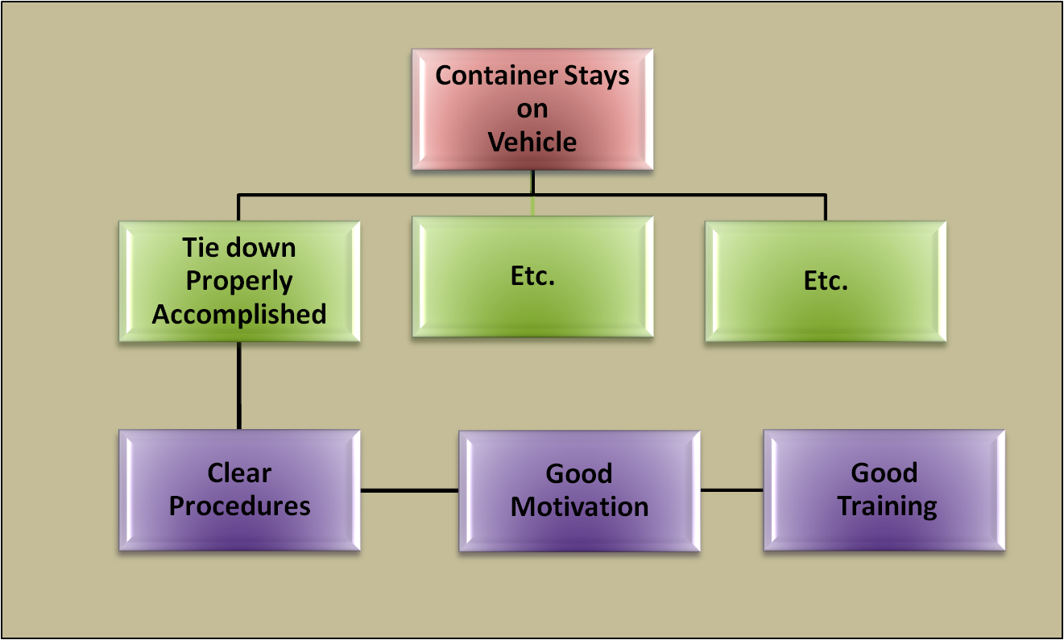
Positive Event Logic Diagram

Slide 74
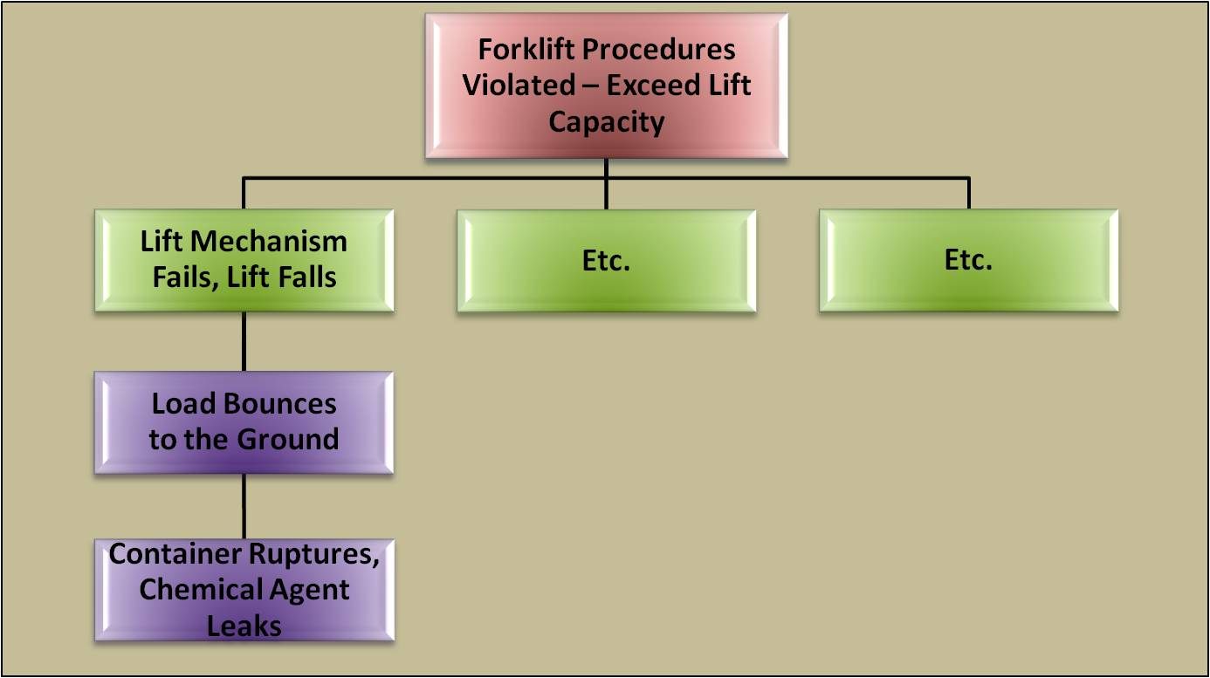
Event Logic Diagram

Slide 75
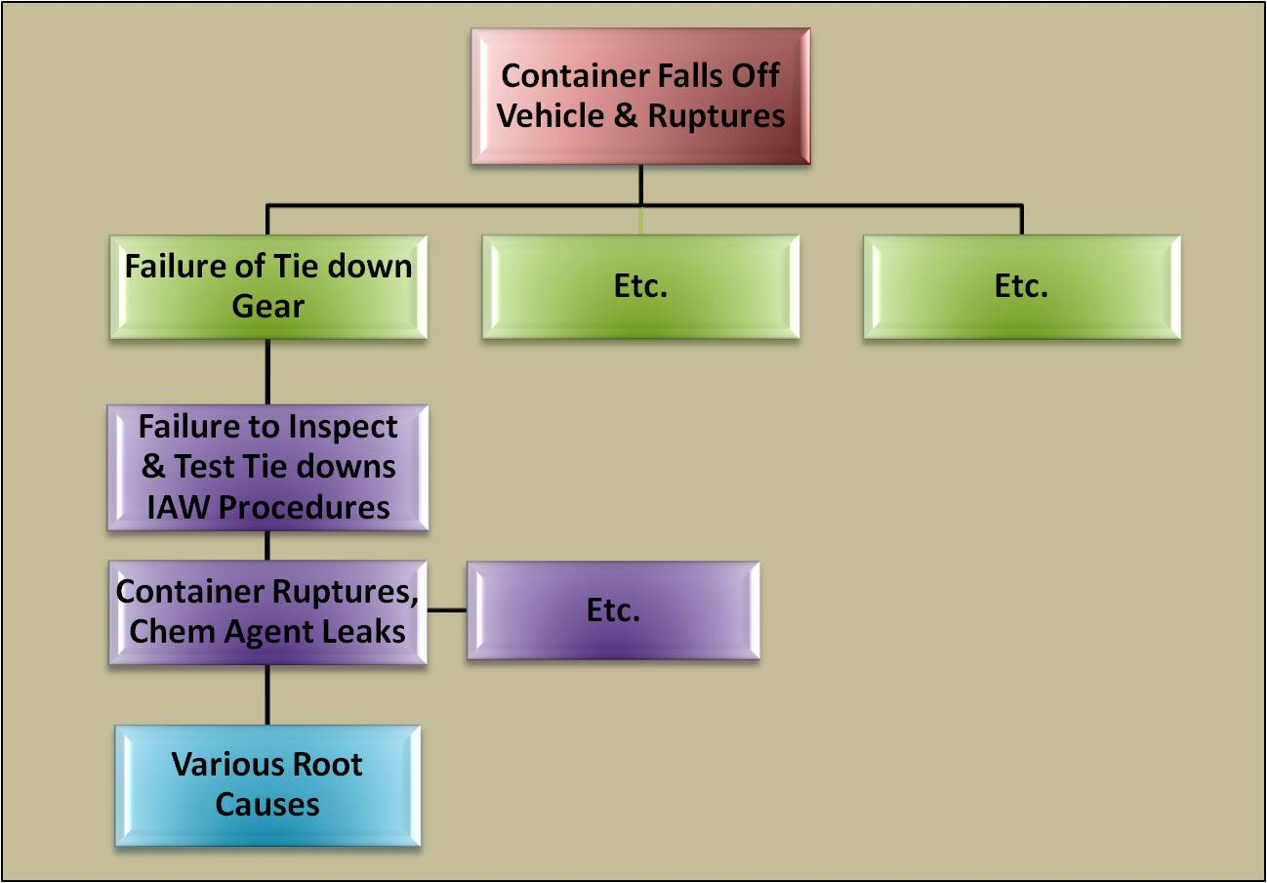
Negative Event Diagram

Slide 76
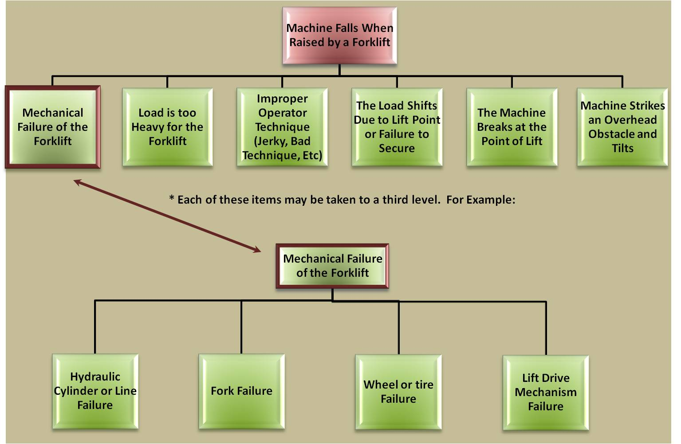
Negative Event Diagram

Slide 77
Change Analysis
Step 1
Action 2:
List Hazards
Step 5
Action 1:
Supervise
Used whenever significant change occurs
Focuses on specific areas of a task that has changed versus the entire event
Analyze the implications of planned or unplanned changes
Used to reveal if any elements exist in current operations that were not previously
considered in original hazard analysis, consider 5-M structure
Experienced personnel who are involved in ongoing operation
One of the most important hazard ID tools
Best applied in mature organizations with established processes
Notes:
EXAMPLE: Mission changes from day-time to a night operation.

Slide 78
The Cause and Effect Tool
Step 1
Action 3:
List Causes
Essentially a logic diagram with more structure through its branches
Like a Logic Diagram, can be positive or negative
Diagram consists of labeling primary arms (bones) of the diagram with major areas of concern
Two basic variations
  Tactical operations ‒ Manpower, Methods, Machinery, Materials, Management
  Administrative process – People, Procedures, Policies, Plant (location)
  Can tailor the basic “bones” based upon the specific operation
Branches off each arm identify hazards associated with each area of concern
Knowledgeable team develops causal factors for each arm and branch
Useful and effective tool for in-depth hazard ID
Notes:
The Fishbone Tool typically goes from right to left, since it is Japanese and became popular in the 60s at Kawasaki ship yards (it was actually developed in 20s).
Good tool for brainstorming with a group of people. Some people feel more comfortable using it than the standard logic diagram.
Often cited in “process improvement” circles.

Slide 79
DAFPAM 90-803 (p.63)

Slide 80
Root Cause
Step 1
Action 3:
List Causes
Identify the “Root” cause of the hazard (5-Whys technique)
Hazards may have multiple root causes (Cause Mapping)
Possible Root Causes within the 5-M Model
  Man – performance errors, judgement, decision making, violations, physical problems, state of mind, sensory misperceptions
  Machine – design, maintenance, technical environment
  Media – physical environment, weather, terrain, altitude, noise, light
  Management – procedures, standards, controls, selection, supervision, support, culture
  Mission – teamwork, planned inappropriate operations, resources
Notes:
To find the root cause, use the “5 Whys” mentioned earlier. Once the root cause is “found,” then appropriate controls can be put in place based on the priorities of the risk assessment.
If this mission or one like this mission has been done in the past there will be after action reports, lessons learned, etc. That will help you decide what to include in your list.

Slide 81
RM Exercise
Break into small groups led by RM Training Facilitators
Questions before we begin?

Slide 82
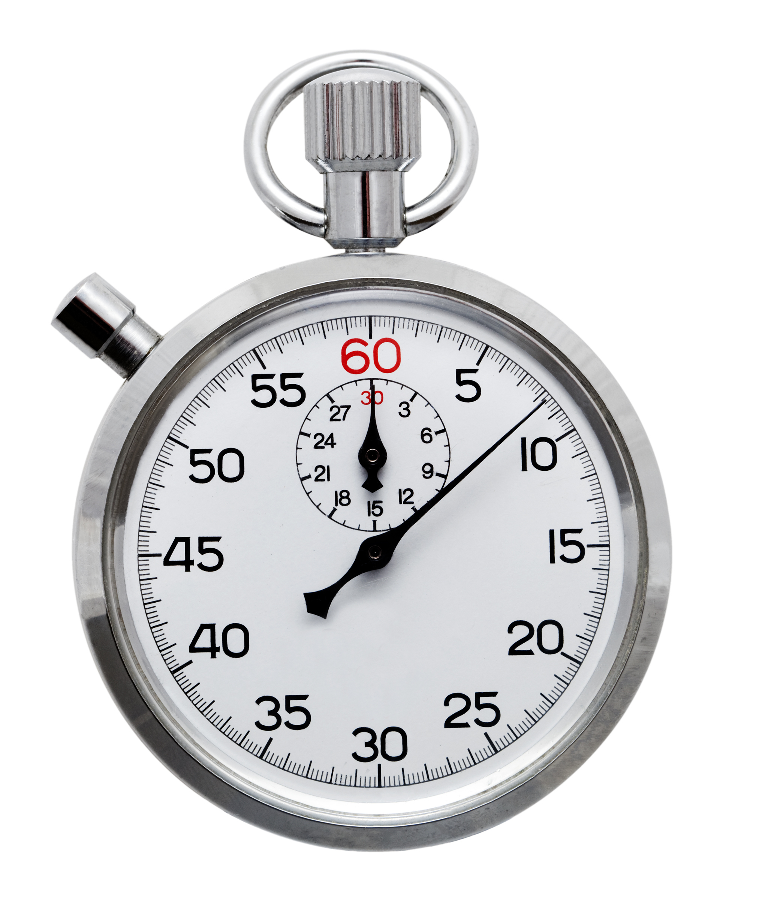
RM Exercise
Reconvene in one hour

Slide 83
Summary
Become familiar with RM concepts and tools and be able to apply them
Continue to integrate RM into all aspects of our mission
Provide feedback on refresher training, JRAT, and other applicable areas NLT 30 days after training completion
  Feedback forms can be found on RM AF Portal site

Slide 84
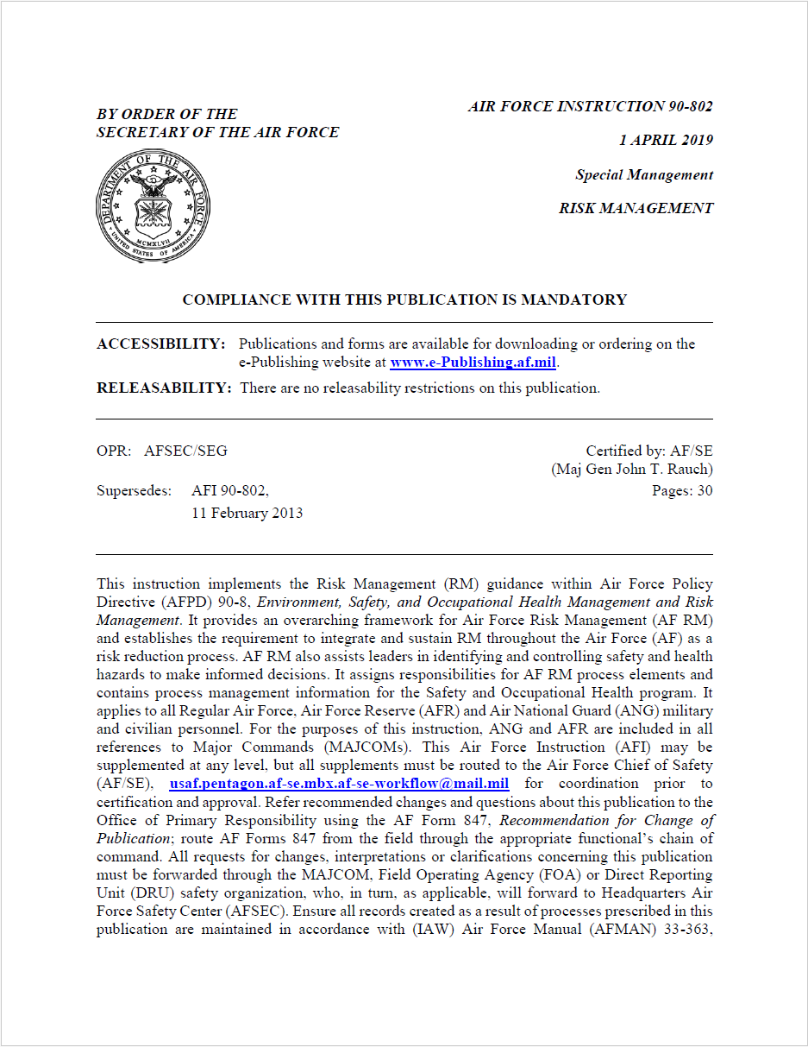
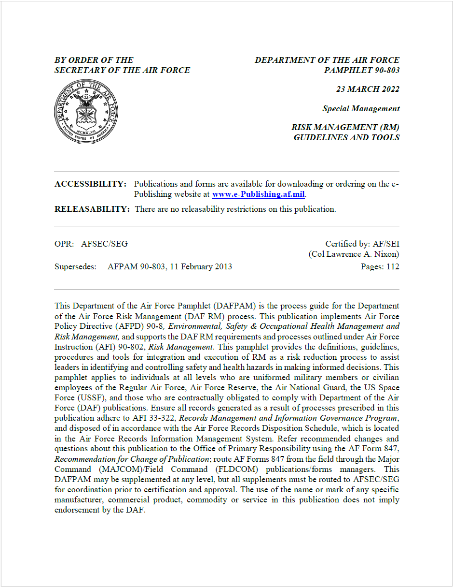
RM Resources
RM concepts, processes, and guidance can be found in DAFI 90-802, Risk Management
RM tools and guidance for preparing a risk assessment worksheet can be found in DAFPAM 90-803, Risk Management (RM) Guidelines and Tools

Slide 85
Links
AFSEC Risk Management Page
  Useful information and links from the Air Force Safety Center
Risk Management AF Portal Site
  Resources for RM training
Risk Management Application and Integration (RM A&I) Training Slides
  Lessons going over RM concepts, processes, and tools
Joint Risk Assessment Tool (JRAT)

Slide 86
QUESTIONS?
Notes:
Review the material covered in the unit.
Ask students if there are any questions.
If no questions, go to next slide lessons learned 45 sec RM---Tell them will be doing a short tree cutting exercise using the 4437 to get familiar with it
Take a break.

